Slide 1

HTTP Client Project Nagamani and Shwe Dec 9, 2024

Slide 2
Agenda
Introduction – Requirements
Design - Architecture
Implementation
Code Analysis
Conclusion

Slide 3

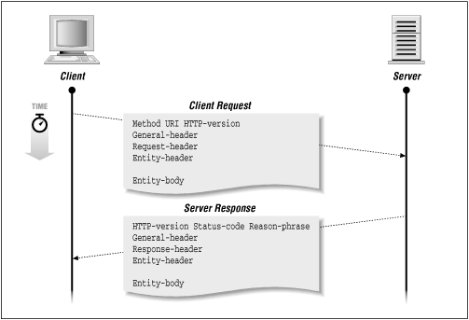
HTTP
Ref: https://www.oreilly.com/openbook/webclient/ch03.html

Slide 4
HTTP Client Implementation in C
Demonstrate HTTP communication using sockets.
Implement Basic Authentication and cookie handling.

Slide 5

INTRODUCTION

Slide 6
Http client Program Requirements
Requirements based on HTTP/1.1 RFC (RFC 2616, updated by RFC 7230-7235)
Establish a reliable connection
Formulate a request line
Include Required headers

Slide 7

Software Design
Architecture

Slide 8
Software Architecture:
Application Layer
HTTP Client
Request Construction
Build GET Request
Headers: Host
User - Agent
Accept-Encoding
Connection Close

Slide 9
Workflow Overview
User Input:
Server IP, credentials, URL, and cookie.
Socket Connection:
Set up and connect to the server.
Request Creation:
Create an HTTP GET request with headers.
Response Handling:
Receive and display server response.

Slide 10
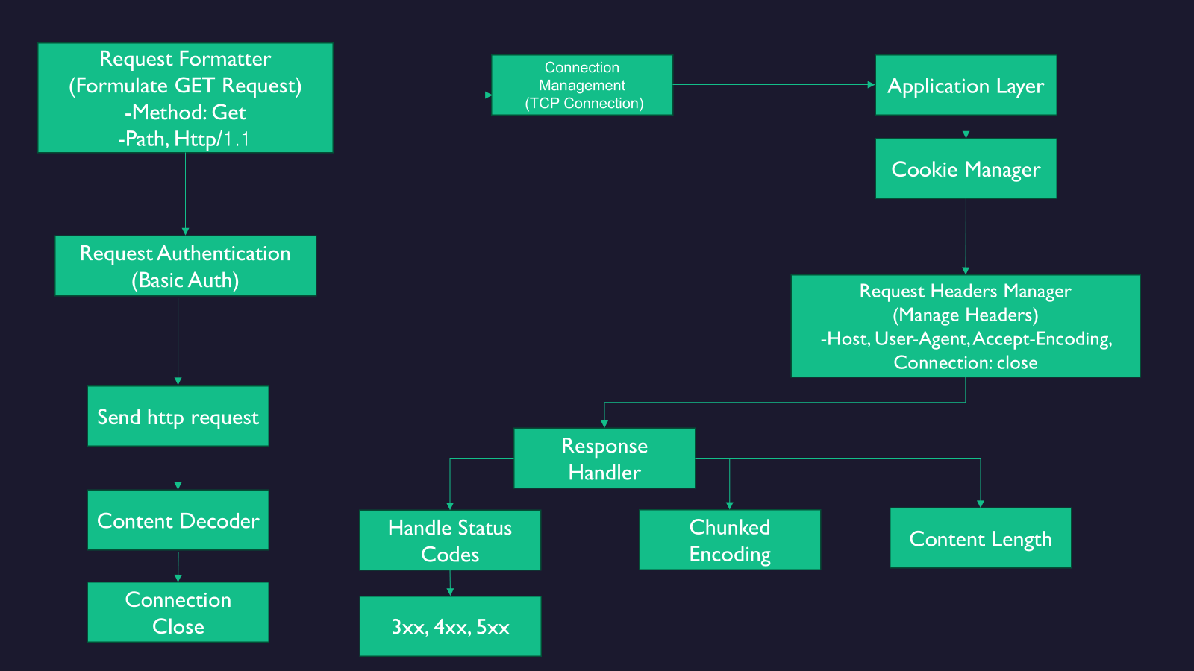

Slide 11
Requirements
1. Establish a TCP connection to the server
✔️ The code establishes a TCP connection to the specified server IP and port (Port 80).
2. Set a cookie value dynamically
✔️ The user is prompted to input the cookie value dynamically, which is then included in the HTTP request.
3. Perform Basic Authentication (username:password)
✔️ The authentication details (username and password) are provided by the user and encoded in Base64.
4. Send HTTP GET requests to access a resource
✔️ The code constructs and sends an HTTP GET request to access the specified resource URL.
5. Handle server response and display it in CLI
✔️ The server's response is received and displayed on the CLI by reading incoming data with recv().
6. Timeout only if the server does not respond within 5 seconds
✔️ A 5-second socket timeout is set using setsockopt() with SO_RCVTIMEO.
7. Error handling for socket creation and connection
✔️ The error() function handles any errors related to socket creation, connection, and request sending.
8. User-friendly CLI interface for input
✔️ Prompts in the CLI ask users to input the server IP, authentication details, URL, and cookie value.
9. Support robust communication with proper resource handling
✔️ The socket is properly closed after communication with close().
10. Ensure proper Base64 encoding for authentication
✔️ The base64_encode() function properly encodes the provided authentication string.

Slide 12
Key Code Snippets
Connection Setup: socket(), connect()
Request Formation: snprintf()
Data Handling: send(), recv()
Authentication: Base64 encoding
Error Handling: perror(), exit()
Timeouts: setsockopt()
Notes:
Show base64_encode() function.
Highlight snprintf usage for constructing the HTTP request.

Slide 13
XAMPP Server Integration
Setup:
Install XAMPP (a local server environment for Apache, MySQL, PHP, and Perl) and configure a PHP script.
Start the Apache server in the XAMPP Control Panel.
Make the IP address discoverable.
Testing:
Interact with the XAMPP server using the HTTP client.

Slide 14
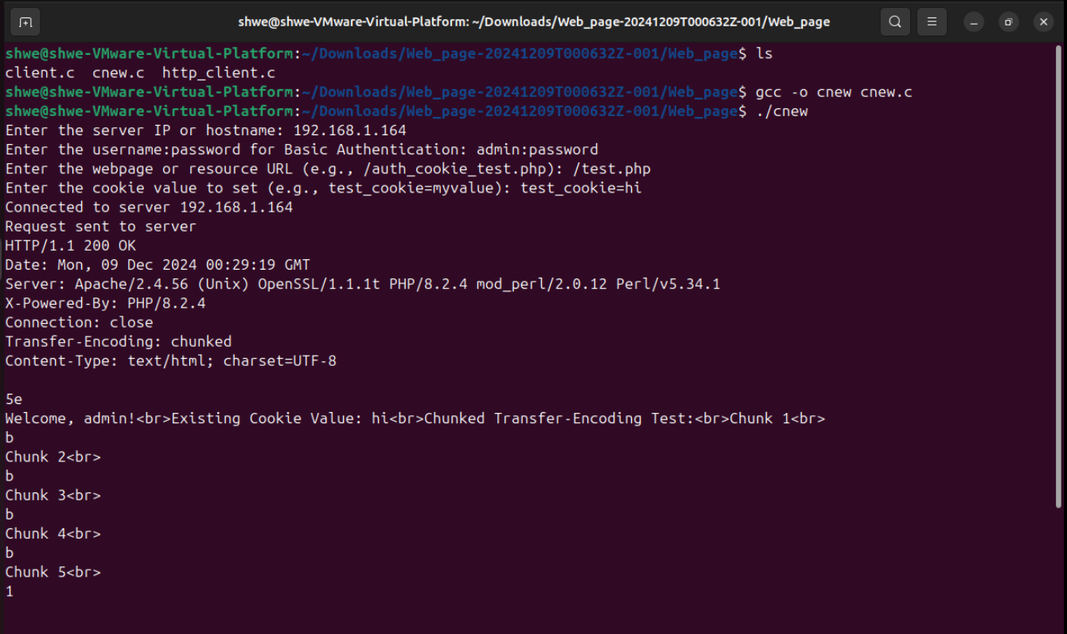
HTTP Client Running:
Notes:
The client sends a request to the XAMPP server and prints the server’s response, which includes:Authorization header with Base64-encoded credentials.
Cookie value received by the server.
Request path.

Slide 15
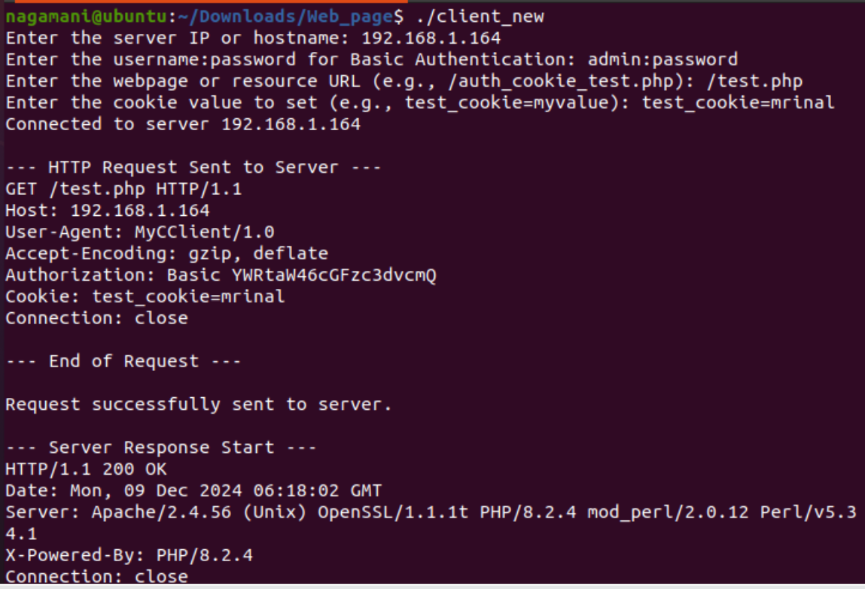
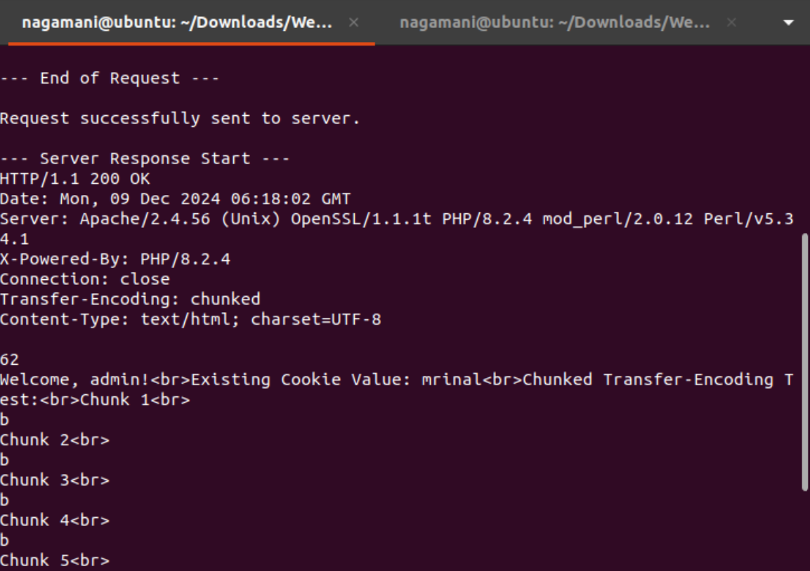
HTTP Client Request and Server Response

Slide 16
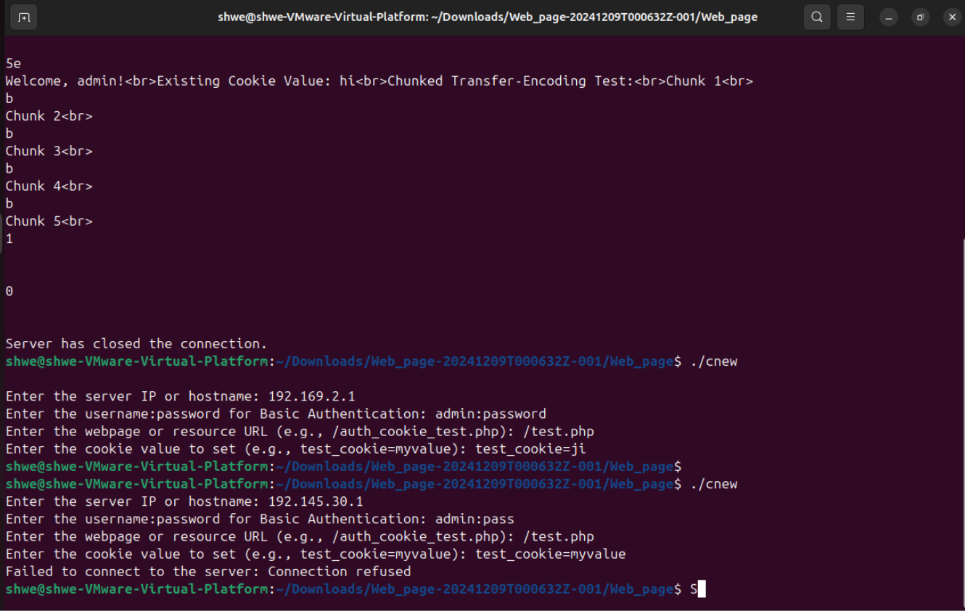
HTTP Client connection Refused:

Slide 17
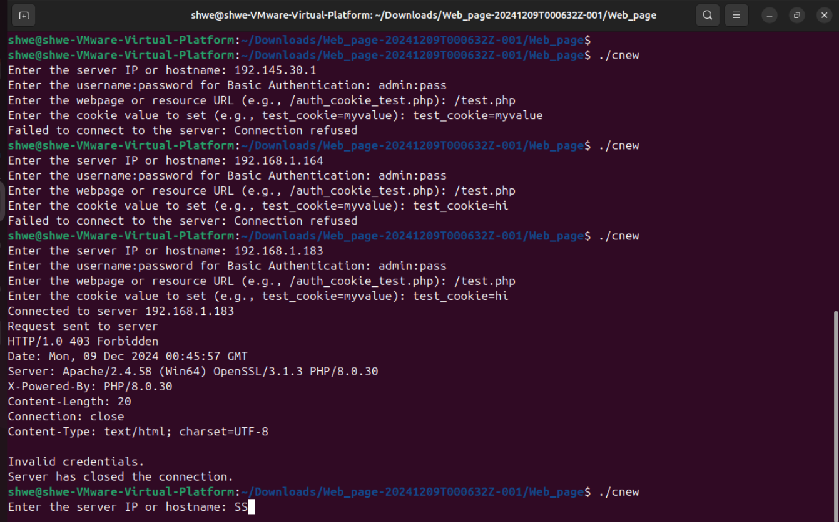
Authentication Error

Slide 18
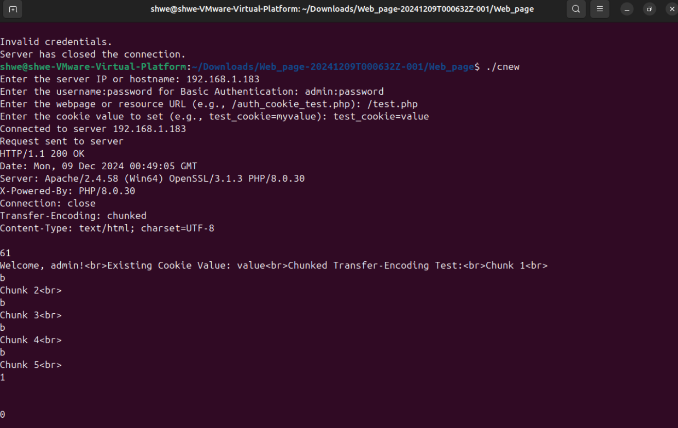
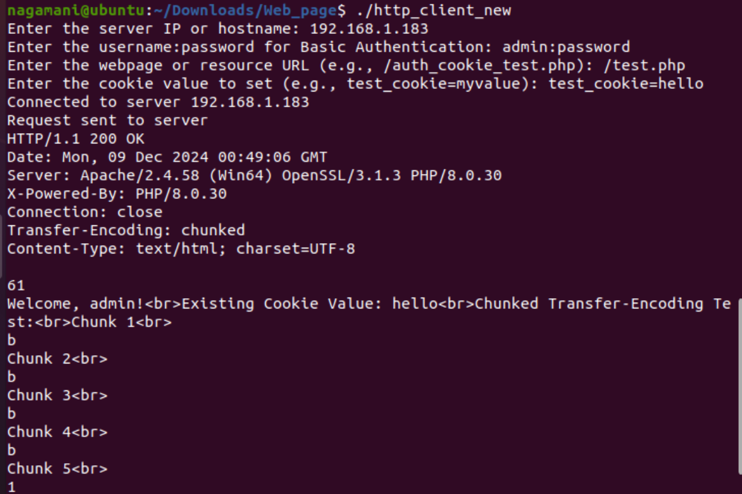
Parallel Connection: Multiple HTTP Clients

Slide 19
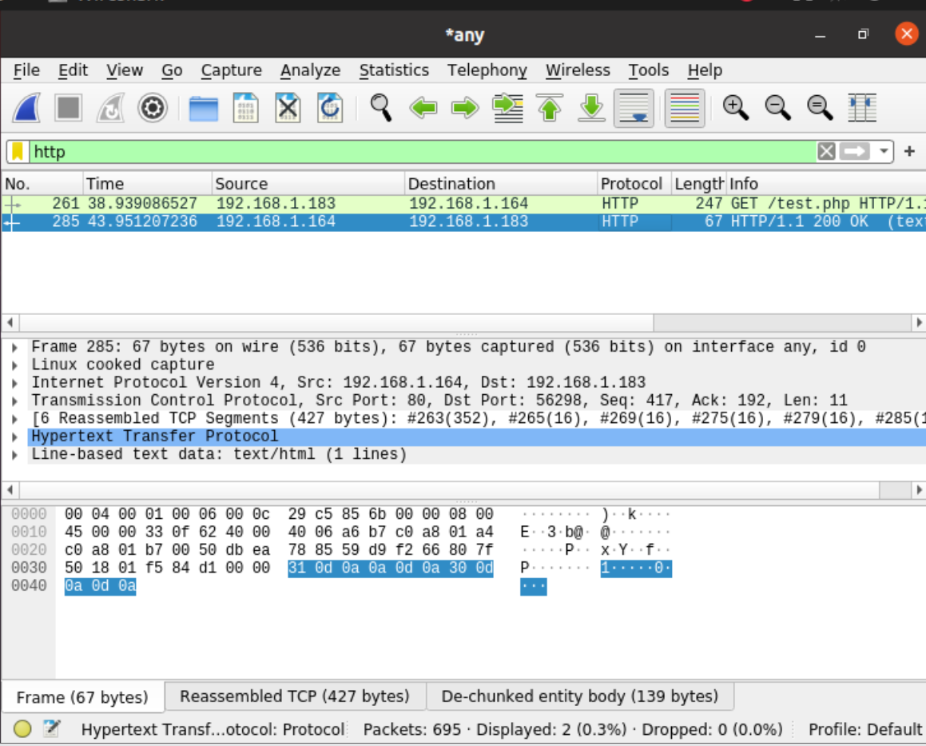
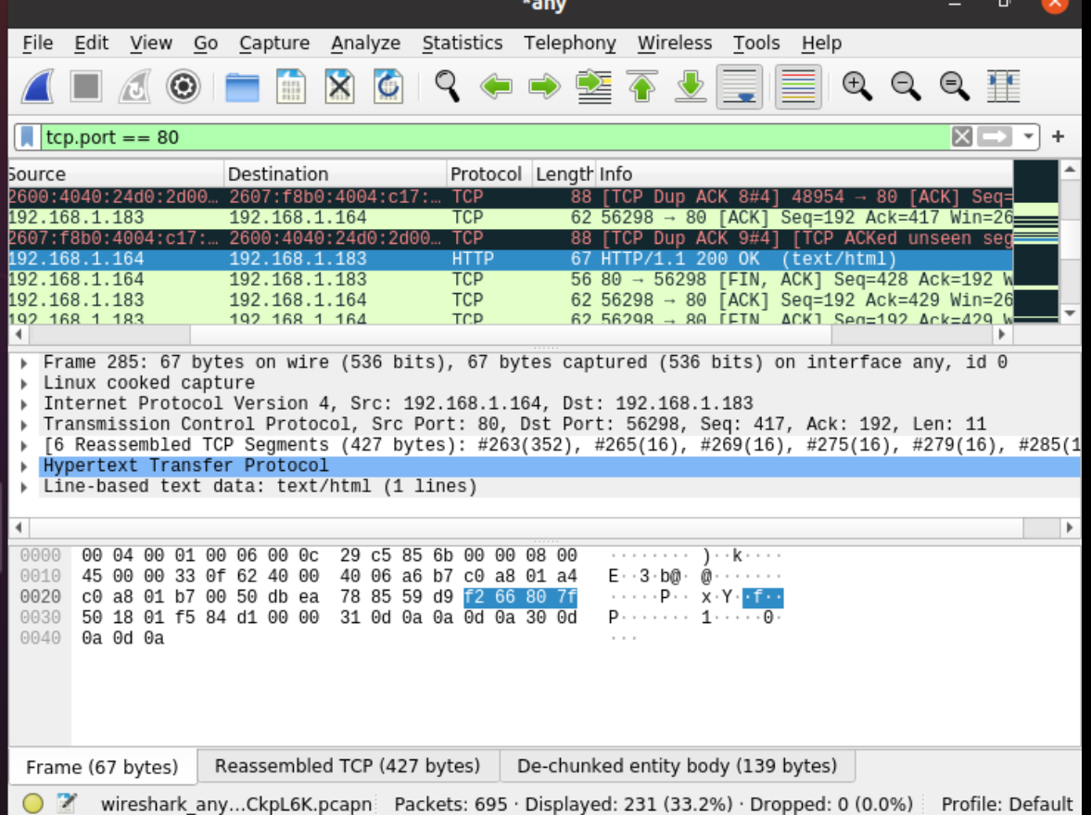
Wireshark Capture: Http client

Slide 20
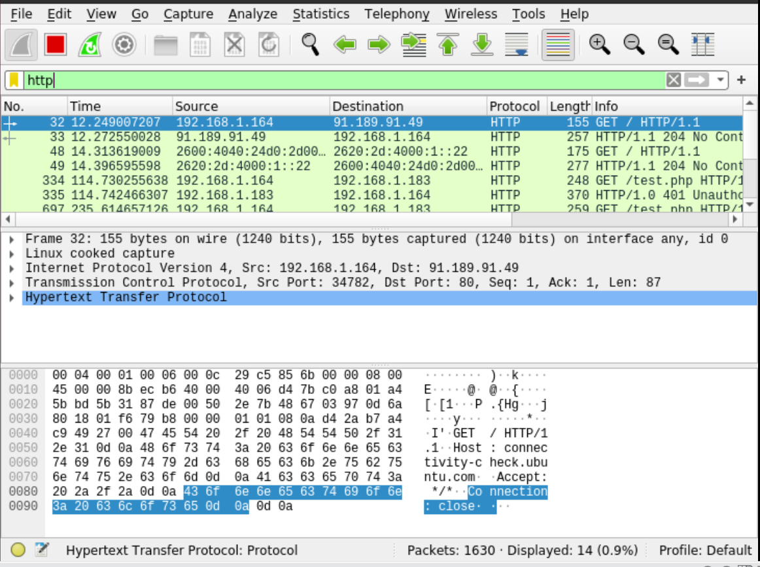
Wireshark Capture

Slide 21

Thank you

